Slide 1
Predicting customer buying behavior on ecommerce site
Using Artificial Neural Network
A Project on Partial Fulfillment of Certificate Course in Business Analytics
Under the guidance of: Prof. Regi Matthew
Submitted by: Abir Jameel
NMIMS, Bangalore

Slide 2
Introduction
In this project we are predicting the customer purchase behavior visiting an ecommerce site using Logistic Regression and Artificial Neural Network.
The data in this study has been taken from UCI Machine Learning Repository. The data contains Variables which records the behavior of customers visiting the ecommerce site.
This Study will Directly impact the monetary value to the company, since they will be able to get the user actions in advance and they can attract customers by providing lucrative deals and offers.

Slide 3
Introduction
Few of the Impacts that will help company are as follows:
Predicting bounce and prompt action may be taken.
Discover which areas of the site are weak in terms of attracting customers.
Whether customers are comfortable with the website of mobile App.
Management will be able make data-driven decisions on different policies and offers.
They can improve the website functioning and user experience.

Slide 4
Introduction of Data
Let’s Discuss about variables in Data.
Column name:
Is_mobile (0/1) – whether the customer is visiting site from mobile.
N_products_viewed (Int >=0) – No. of products viewed.
Visit_duration (real(secs) >= 0) – Duration of visit in seconds
Is_returning_visitor (0/1) – Whether a frequent visitor or a new one.
Time_of_day (Time Stamp) – The Time of Day
User_actions (bounce/ add_to_cart / begin_checkout / finish_checkout) – actions of users.
And many others (which do not add significance to the model), but for the scope of this study I have taken only these many variables.

Slide 5
Introduction to Data preprocessing
Since Logistic Regression and Neural Networks work on numerical vectors, not
categories. So we have to do One-hot Encoding (Creating Dummy Variables.
Ex. Time of the day is converted to 0/1/2/3.
Similarly for user actions variable.
For Data Preprocessing I have defined some functions in python which will help us process our data or get the data in shape for modeling purpose. The Detail of all those functions are commented in code file.
12am – 6am | 6am – 12pm | 12pm – 6pm | 6pm – 12am
1 | 0 | 0 | 0
0 | 1 | 0 | 0
0 | 0 | 1 | 0
0 | 0 | 0 | 1

Slide 6
Lets model it !
For this project we have used Logistic Regression and Artificial Neural Networks(ANN) modeling techniques.
In both of the techniques weights calculation/optimization has been done by using Gradient Descent instead of maximum likelihood estimator.
In Logistic Regression we have used to predict Binary user_actions i.e. bounce / add_to_cart .
And, we have also used multiclass Logistic Regression using softmax technique.
We have used a function get_binary_data(can be found in code) to process data for only two categories to be used in logistic regression.
In ANN since we can predict multiple categories so we have used all of the user actions to predict the user_actions.
For Training and Test Data, 90% of data used for Training and remaining 10% as Testing data.

Slide 7
Lets model it !
y2indicator is for converting four classes of dependent variable to four dummy variables.
The Modeling is done in Python and packages that are used in this study are as follows
Numpy
Pandas
Sklearn
Using jupyter notebook for coding the machine learning codes which gives clean and clear readability and shareable features.
Code is well commented for better understanding.
And Tableau for Visualizing the Dataset.

Slide 8
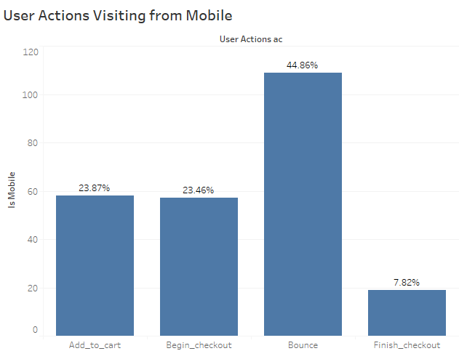
What Does Data Say !

Slide 9
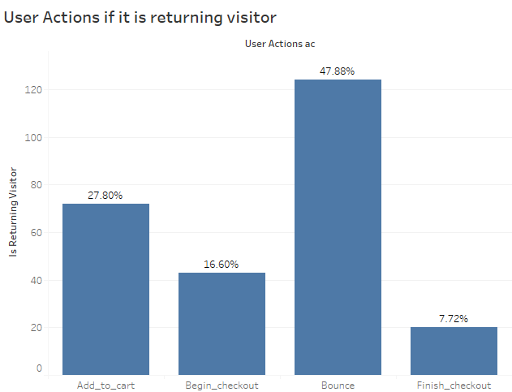
What Does Data Say !

Slide 10
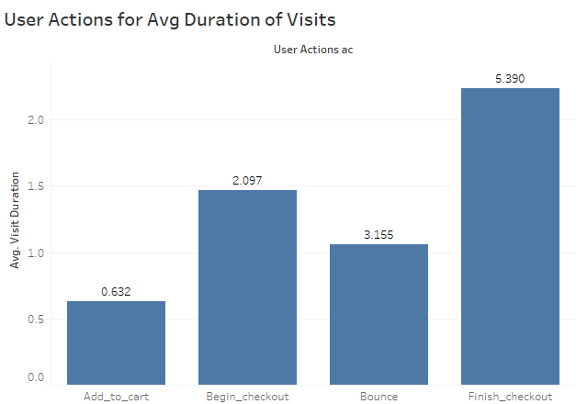
What Does Data Say !

Slide 11
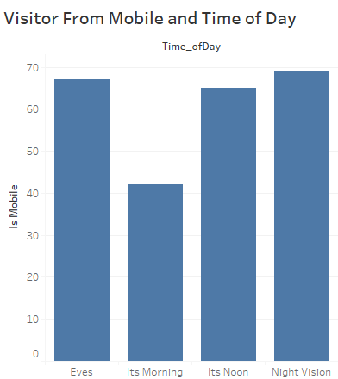
What Does Data Say !

Slide 12
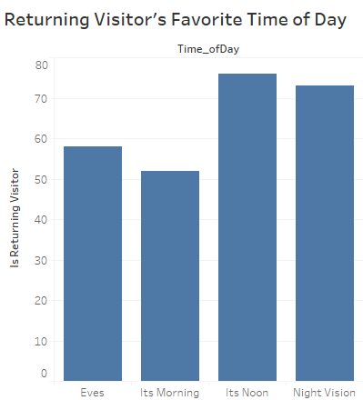
What Does Data Say !

Slide 13
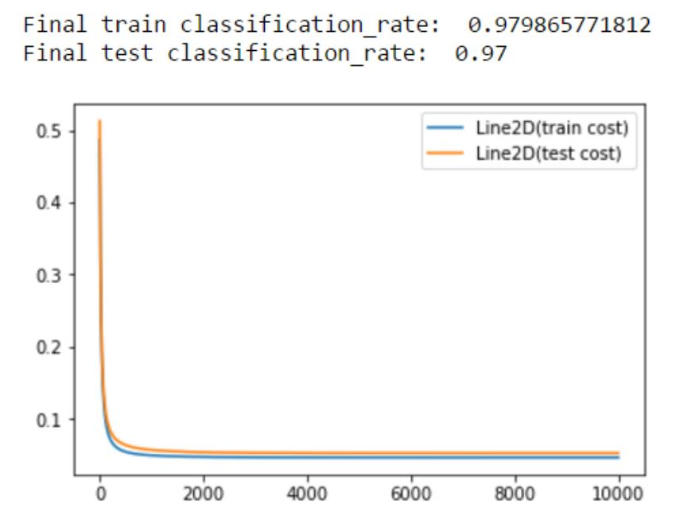
Lets discuss our results
Binary Classification Logistic Regression Model Output.
The Figure shows that we do have a pretty good accuracy over predicting based on the features of visitors.
That, Who is going to bounce and who is going to add a product to cart !

Slide 14
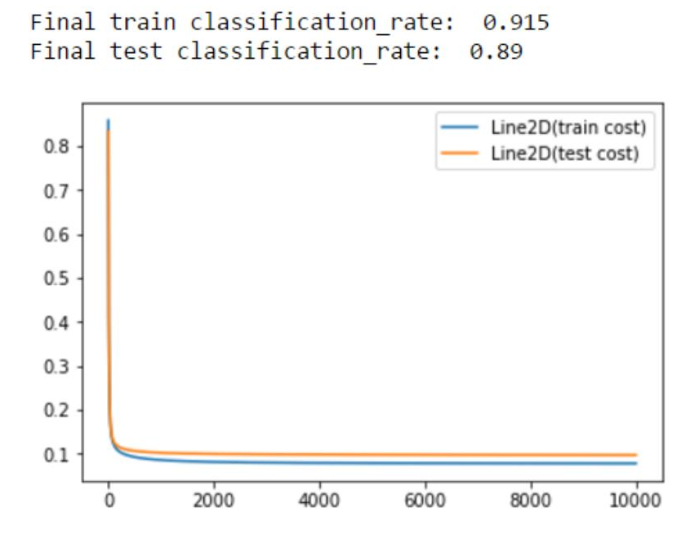
Lets discuss our results
Multi-Class Classification Logistic Regression Model Output.
The Figure shows that we do have a pretty good accuracy over predicting based on the features of visitors.
That, Who is going to bounce or who is going to add a product to cart or Who will begin the check out but will not end up buying and who is anyway going to buy a product !
So Definitely, if we know whether if a visitor is going to buy or not we can make him buy by providing some offers as soon as he enters the site.

Slide 15
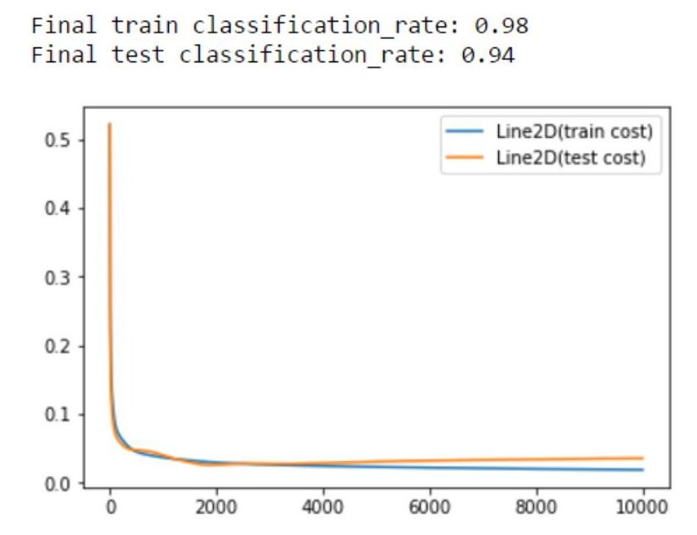
Lets discuss our results
Neural Network Model Output.
The Figure shows that we do have a pretty good accuracy and with all four Classification classes Neural Network performs much better than Logistic Regression over predicting based on the features of visitors.
That, Who is going to bounce or who is going to add a product to cart or Who will begin the check out but will not end up buying and who is anyway going to buy a product !
Accuracy/ Classification rate is 98% on train data and 94% on test data, which makes it more better predictor than Logistic Regression.

